Slide 1

ONE WEEK
DATA SCIENCE

Slide 2

CLASSIFICATION ANALYSIS IN DATA SCIENCE

Slide 3
PROJECT OVERVIEW

Slide 4
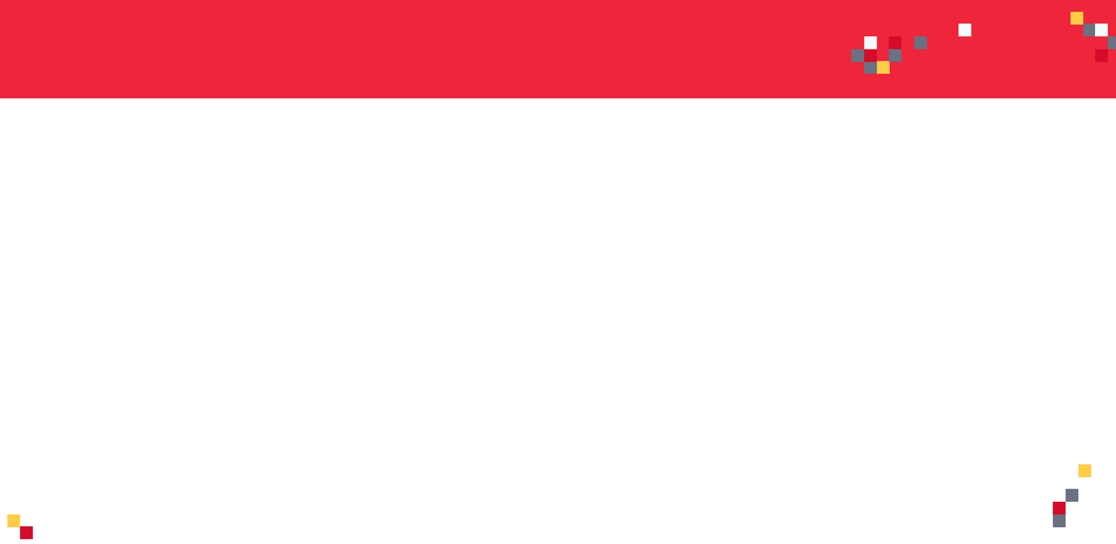

PROJECT OVERVIEW
In this hands-on project, we will train several classification algorithms namely Logistic Regression, Support Vector Machine, K-Nearest Neighbors, and Random Forest Classifier to predict the churn rate of Telecommunication Customers.
Telecom service providers use customer attrition analysis as one of their key business metrics because the cost of retaining an existing customer is far less than acquiring a new one.
Data Science empower companies by analyzing customer attrition rate based on several factors which includes various services subscribed by the customers, tenure rate, gender, senior citizen, payment method, etc.
Image Source: https://pixabay.com/illustrations/family-customer-target-group-ball-563968/
Dataset Source : https://www.kaggle.com/blastchar/telco-customer-churn

Slide 5
INPUTS AND OUTPUTS
INPUTS
OUTPUT
ATTRITION
(0 or 1)
PAYMENT METHOD
TENURE
SUBSCRIBED SERVICES
TOTAL MINUTES
STATE
AREA CODE
INTERNATIONAL PLAN
DAY MINUTES
NIGHT MINUTES
CLASSIFIER MODEL

Slide 6
CLASSIFICATION MODELS KPIs

Slide 7
CLASSIFICATION MODEL KPIs
Classiﬁcation Accuracy = (TP+TN) / (TP + TN + FP + FN)
Misclassiﬁcation rate (Error Rate) = (FP + FN) / (TP + TN + FP + FN)
Precision = TP/Total TRUE Predictions = TP/ (TP+FP) (When model predicted TRUE class, how often was it right?)
Recall = TP/ Actual TRUE = TP/ (TP+FN) (when the class was actually TRUE, how often did the classiﬁer get it right?)
+
-
TRUE CLASS
+
TRUE +
FALSE +
PREDICTIONS
FALSE -
TRUE -
-

Slide 8
DIABETES EXAMPLE
TRUE CLASS
FACTS:
100 PATIENTS TOTAL
91 PATIENTS ARE HEALTHY
9 PATIENTS HAVE DIABETES
+
-
Accuracy is generally misleading and is not enough to assess the performance of a classifier.
Recall is an important KPI in situations when dataset is highly unbalanced; cases when you have small diabetes patients compared to healthy ones.
TP = 1
FP = 1
+
PREDICTIONS
-
FN = 8
TN = 90
Classiﬁcation Accuracy = (TP+TN) / (TP + TN + FP + FN) = 91%
Precision = TP/Total TRUE Predictions = TP/ (TP+FP) = ½=50%
Recall = TP/ Actual TRUE = TP/ (TP+FN) = 1/9 = 11%

Slide 9
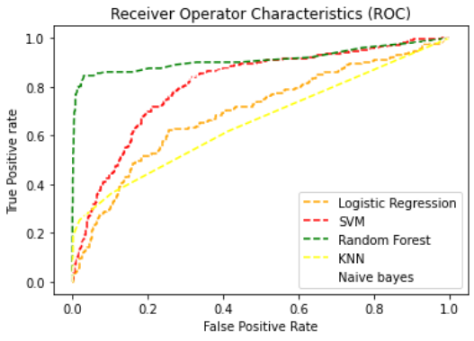
ROC (RECEIVER OPERATING CHARACTERISTIC CURVE)
ROC Curve is a metric that assesses the model ability to distinguish between binary (0 or 1) classes.
ROC curve is created by plotting the true positive rate (TPR) against the false positive rate (FPR) at various threshold settings.
Points above the diagonal line represent good classification (better than random)
The model performance improves if it becomes skewed towards the upper left corner.
Photo Credit: https://commons.wikimedia.org/wiki/File:Roccurves.png

Slide 10
AUC (AREA UNDER CURVE)
PREDICTOR #1
The light blue area represents the area Under the Curve of the Receiver Operating Characteristic (AUROC).
The diagonal dashed red line represents the ROC curve of a random predictor with AUROC of 0.5.
If ROC AUC = 1, this means perfect classifier
The higher the AUC, the better the model is at predicting 0s as 0s and 1s as 1s.
PREDICTOR #2
TRUE POSITIVE RATE
RANDOM PREDICTOR
FALSE POSITIVE RATE
Predictor #1 is better than predictor #2

Slide 11
CODE DEMO

Slide 12
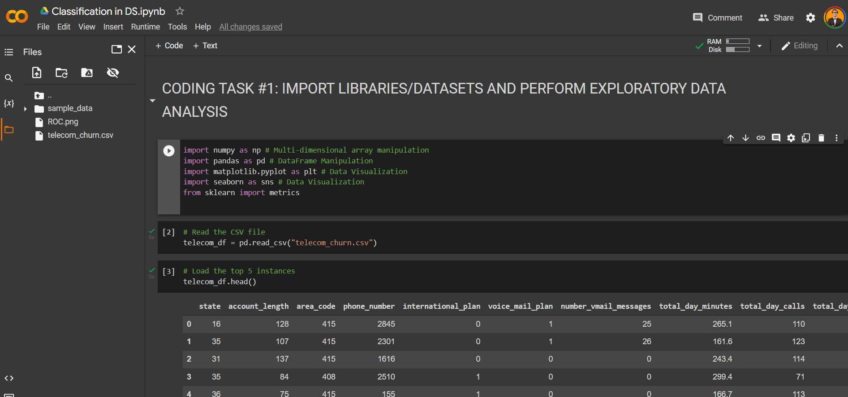
CODE DEMO

Slide 13
FINAL CAPSTONE PROJECT

Slide 14
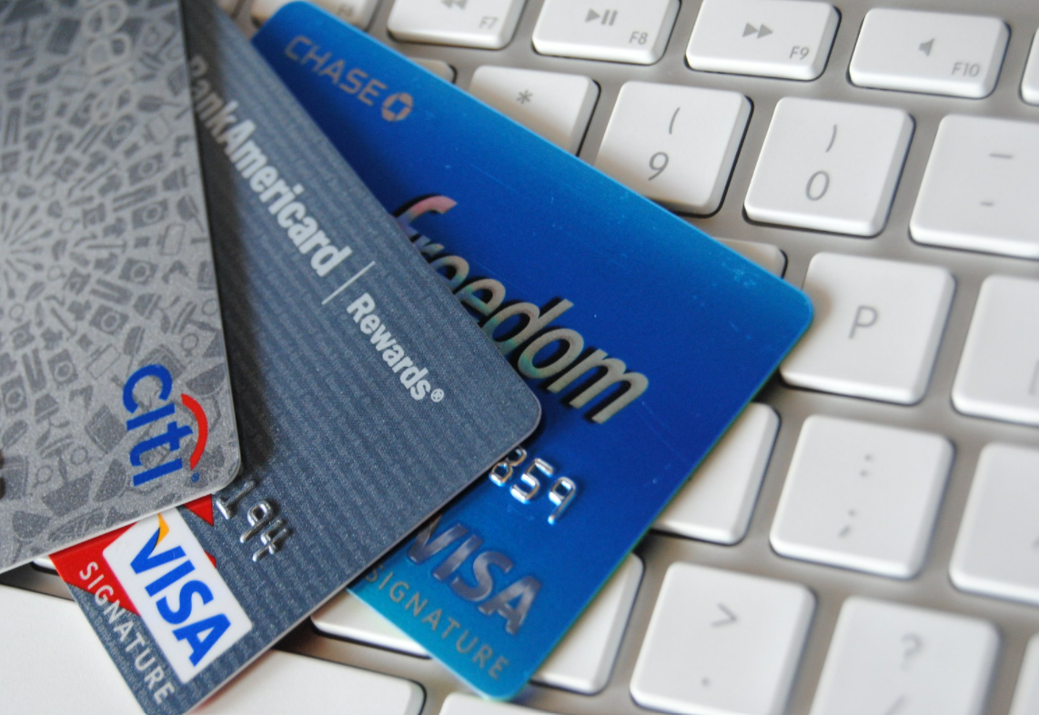
PROJECT OVERVIEW
Assume that you work as a data scientist at a bank in Taiwan.
The bank has collected extensive data about its customers such as demographics, historical payments record, amount of bill dollar values.
Data has been collected between April 2005 to September 2005.
The data consists of 25 variables. Let’s explore these variables in the next slide!
Data Source: https://www.kaggle.com/uciml/default-of-credit-card-clients-dataset

Slide 15
INPUTS/OUTPUTS
OUTPUT:
default.payment.next.month: Default payment (1=yes, 0=no)
INPUTS:
ID: ID of each client
LIMIT_BAL: Amount of given credit in NT (New Taiwan) dollars
SEX: Gender (1=male, 2=female)
EDUCATION: (1=graduate school, 2=university, 3=high school, 4=others, 5=unknown, 6=unknown)
MARRIAGE: Marital status (1=married, 2=single, 3=others)
AGE: Age in years
PAY_0: Repayment status in Sep, 2005 (-1=pay duly,
1=payment delay for one month, 2=payment delay for two months, ... 8=payment delay for eight months, 9=payment delay for nine months and above)
PAY_2: Repayment status in August, 2005 (scale same as above)
PAY_3: Repayment status in July, 2005 (scale same as above)
PAY_4: Repayment status in June, 2005 (scale same as above)
PAY_5: Repayment status in May, 2005 (scale same as above)
PAY_6: Repayment status in April, 2005 (scale same as above)
BILL_AMT1: Amount of bill statement in September, 2005 (NT dollar)
BILL_AMT2: Amount of bill statement in August, 2005 (NT dollar)
BILL_AMT3: Amount of bill statement in July, 2005 (NT dollar)
BILL_AMT4: Amount of bill statement in June, 2005 (NT dollar)
BILL_AMT5: Amount of bill statement in May, 2005 (NT dollar)
BILL_AMT6: Amount of bill statement in April, 2005 (NT dollar)
PAY_AMT1: Amount of previous payment in September, 2005 (NT dollar)
PAY_AMT2: Amount of previous payment in August, 2005 (NT dollar)
PAY_AMT3: Amount of previous payment in July, 2005 (NT dollar)
PAY_AMT4: Amount of previous payment in June, 2005 (NT dollar)
PAY_AMT5: Amount of previous payment in May, 2005 (NT dollar)
PAY_AMT6: Amount of previous payment in April, 2005 (NT dollar)

Slide 16
FINAL CAPSTONE PROJECT TASKS
Complete the following tasks:
Import the "UCI_Credit_Card.csv" dataset
Perform Exploratory Data analysis and visualization (feel free to pick any reasonable data visualizations)
Prepare the data for model training and split it into training and testing
Train and evaluate an XG-Boost classifier model
Train and evaluate a Support Vector Machine classifier model
Train and evaluate a Naive Bayes classifier model
Train and evaluate a logistic regression model
Train and evaluate a Random Forest classifier model
Train and evaluate a K-Nearest Neighbors classifier model
Plot the ROC curve for all classifier and calculate the AUC
Which model performs best?

